Slide 1
Digital Image Processing Lecture 0 Simple Matlab Tutorial
Zhilai Liu
School of Mathematics
LNU September 1, 2020

Slide 2


Outline
1
Background on Matlab
2
Matlab Working Environment
3
Matlab and Image Processing Toolbox
4
Matlab Programming

Slide 3
What is Matlab?
Background on Matlab
Matlab stands for matrix laboratory, and it is developed by the MathWorks, Inc. http://www.mathworks.com/
MATLAB is an interactive system whose basic data element is an array.
It is a high-performance language for technical computing
This allows formulating solutions to many technical computing problems, especially those involving matrix representations
in a fraction of the time it would take to write a program in a scalar noninteractive language such as C or Fortran
It integrates computation, visualization, and programming in an easy-to-use environment.
It is a strong computational tool for university ( mathematics, engineering, and science) and Industry (research, development, and analysis).

Slide 4
What is Matlab?
Background on Matlab
Typical uses of Matlab include the following:
Math and computation Algorithm development Data acquisition
Modeling, simulation, and prototyping
Data analysis, exploration, and visualization Scientific and engineering graphics
Application development, including graphical user interface building
MATLAB contains a family of toolboxes for various applications.
The Image Processing Toolbox (IPT): extend the capability of the MATLAB environment for the solution of digital image processing problems
Other toolboxes that sometimes are used to complement IPT are the Signal Processing, Neural Network, Fuzzy Logic, and Wavelet Toolboxes

Slide 5
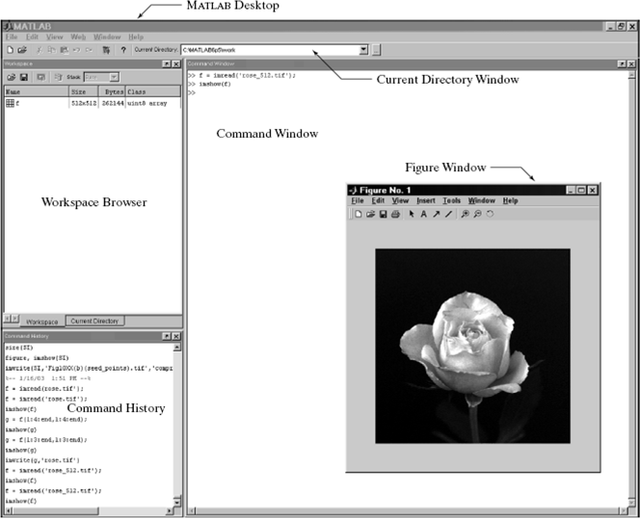
Matlab Working Environment
Matlab Working Environment

Slide 6
Current Directory and Search path
Matlab Working Environment
Any file run in MATLAB must reside in the current directory or in a directory that is on the search path
By default, the files supplied with MATLAB and MathWorks toolboxes are included in the search path
Add or modify a search path, is to select Set Path from the File
menu on the desktop

Slide 7
Using the MATLAB Editor to Create M-files
Matlab Working Environment
The MATLAB editor is both a text editor specialized for creating M-files and a graphical MATLAB debugger.
Source files are denoted by the extension .m
The editor performs some simple checks and also uses color to differentiate between various elements of code
The file must be in the current directory, or in a directory in the search path.

Slide 8
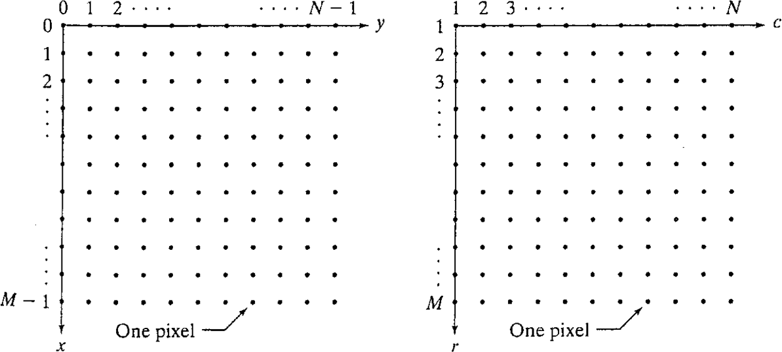
Digital Image Representation
Matlab and Image Processing Toolbox
Coordinate Conventions
Images as Matrices


f (0, 0),
f (1, 0),
f (0, 1),
f (1, 1),
· · · ,
f (0, N − 1)
· · · ,
f (1, N − 1)
f (x, y) =

.
.
. .
.


.
f (M − 1, 0),
.
f (M − 1, 1),
.
.

· · · ,
f (M − 1, N − 1)

Slide 9
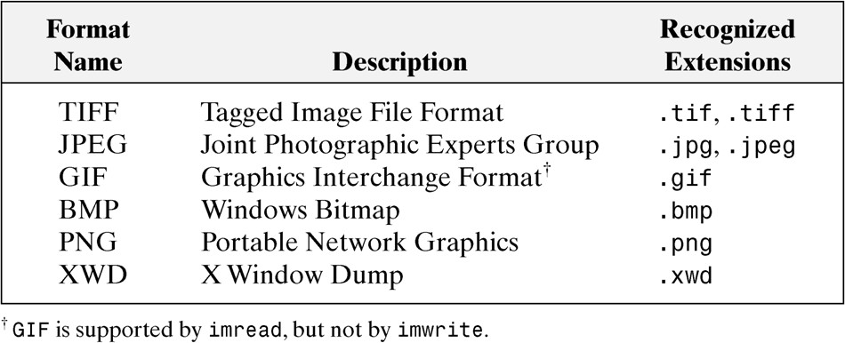
Read an Image
Matlab and Image Processing Toolbox
Image formats
Read an image using MATLAB IPT
f=imread(’bird.jpg’);
Imread reads the file from the current directory and, if fails, it tries to find the file in the search path
Please notice the semicolon(;). If erase it, the command window will show the image²s matrix value

Slide 10
Obtain the Information of an Image
Matlab and Image Processing Toolbox
size(f)
ans = 230 352 3
whos f
Name Size Bytes Class
f 230x352x3 242880 uint8 array
Grand total is 242880 elements using 242880 bytes
imfinfo(‘bird.jpg²) show more info than whos
ans = Filename: ’bird.jpg’ FileModDate: ’25-Sep-2002 19:00:16’
FileSize: 7028
Format: ’jpg’ FormatVersion: ” Width: 352
Height: 230
BitDepth: 24 ColorType: ’truecolor’ FormatSignature: ” NumberOfSamples: 3
CodingMethod: ’Huffman’
CodingProcess: ’Sequential’
1
2
3
Comment: {’ACD Systems Digital Imaging’}

Slide 11
Show or Write an Image
Matlab and Image Processing Toolbox
imshow(f) imshow(f, G) imshow(f,[low,high]) imshow(f,[])
An demo example 2.1
imwrite(f,²filename²) imwrite(f,²filename²,²ext²) imwrite(f,²filename²,²quality²,q)
The quality q ranges from 0 to 100, the lower the number , the quality is worse, but the compression is higher

Slide 12
Image Types
Matlab and Image Processing Toolbox
Intensity images
An intensity image is a data matrix whose values have been scaled to represent intensities.
When the elements of an intensity image are of class uint8 or uint16, they have integer values in the range [0,255] or [0,65535].
If the image is of class double, the values are floating-piont numbers. Values of scaled, class double intensity images are in the range [0,1] by convention
Binary images
A binary image is a logical array of 0s and 1s.
A numeric array is converted to binary using function logical.
If A contains elements other than 0s and 1s, use of the logical function converts all nonzero quantities to logical 1s and all entries with value 0 to logical 0s
Indexed images RGB images

Slide 13
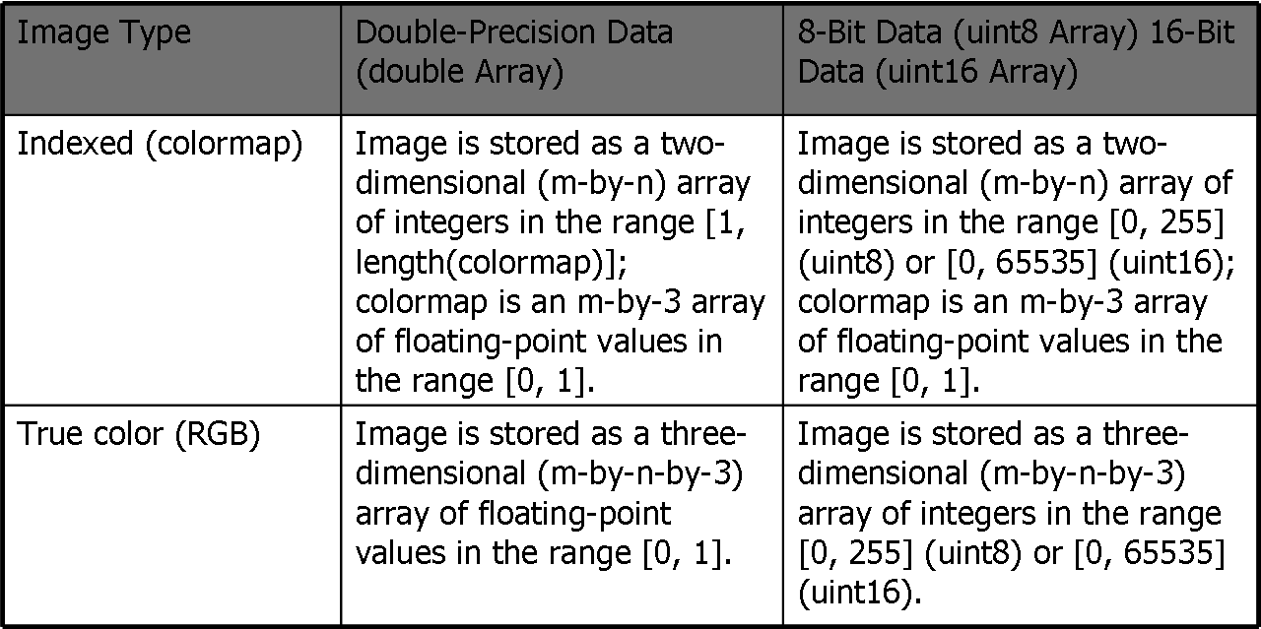
Indexed Image and RGB Image
Matlab and Image Processing Toolbox
Image data can be either indexed or true color.
An indexed image stores colors as an array of indices into the figure colormap.
A true color image does not use a colormap; instead, the color values for each pixel are stored directly as RGB triplets.
In MATLAB, the CData property of a truecolor image object is a three-dimensional (m-by-n-by-3) array. This array consists of three m-by-n matrices concatenated along the third dimension.

Slide 14
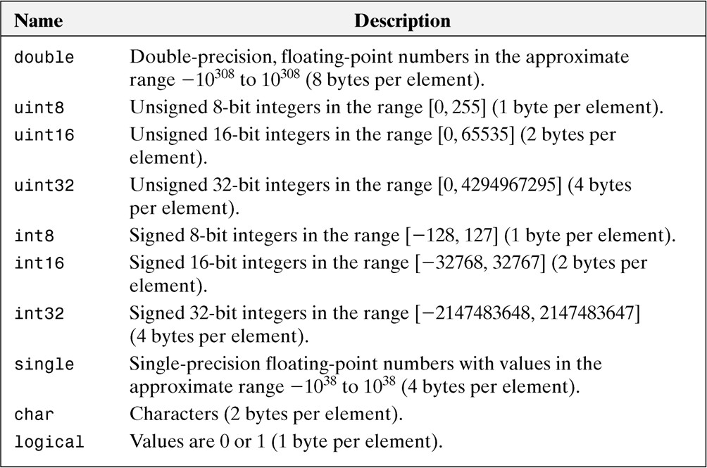
Matlab and Image Processing Toolbox
Data Types

Slide 15
Converting between Data Types and Image Types
Matlab and Image Processing Toolbox
In general, we refer to an image as being a ”data image type” image
For instance, a statement discussing an ”unit8 intensity image” is simply referring to an intensity image whose pixels are of data class unit8.
Converting between data classes is straightforward. The general syntax is
B = data class name(A)
where data class-name is one of the names in the first column of data class table.
For example, suppose that A is an array of class uint8. A double precision array, B. is generated by the command B = double (A). This conversion is used routinely throughout the book because MATLAB expects operands in numerical computations to be double precision, floating point numbers

Slide 16
Converting between Data Classes
Matlab and Image Processing Toolbox
For any data types (uint8, logical...), conversion can be easily completed without precision loss.
For an array of class double, any values outside the range of the destination class will be replaced by the corresponding boundary values.
If converting a double matrix to an integer matrix, numbers in between ar converted to integers by discarding their fractional parts
If converting a double matrix to an logical matrix, the logical 1s are generated where the input array had nonzero values and logical 0s in places where the input array contained 0s.

Slide 17
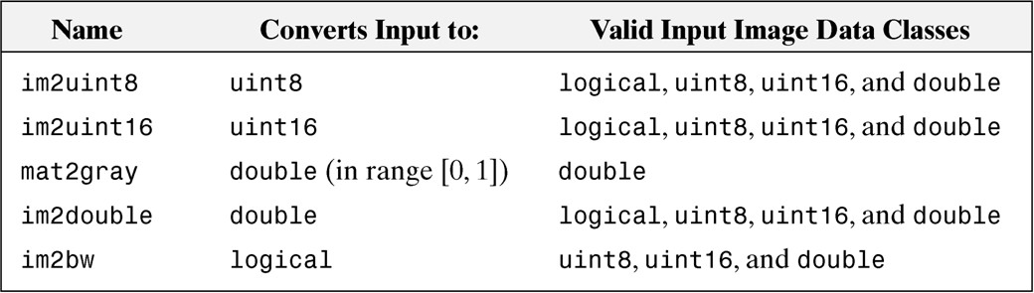
Matlab and Image Processing Toolbox
Converting between Data Types and Image Types (cont.)
The toolbox provides specific functions that perform the scaling necessary to convert between image classes and types.
Functions in IPT for converting between image classes and types
W.Q. Wang (SISE,GUCAS)

Slide 18
Converting between Data Types and Image Types (cont.)
Matlab and Image Processing Toolbox
Function im2uint8 detects the data class of the input and performs all the necessary scaling for the toolbox to recognize the data as valid image data.
For example, consider the following 2 × 2 image f of class double, which could be the result of an intermediate computation
f=
-0.5 0.5
0.75 1.5
G=im2uint8(f) G=
0 128
191 255

Slide 19
Converting between Data Types and Image Types (cont.)
Matlab and Image Processing Toolbox
Converting an arbitrary array of class double to an array of class double scaled to the range [0,1] can be accomplished by using function mat2gray whose basic syntax is
G = mat2gray(A,[Amin,Amax])
where image g has values in the range 0 (black) to 1 (white).The specified parameters Amin and Amax are such that values less than(including equal to) Amin in A become 0 in g,and values greater than(including equal to) Amax in A correspond to 1 in g.
G = mat2gray(A)
sets the values of Amin and Amax to the actual minimum and maximum values in A

Slide 20
Converting between Data Types and Image Types (cont.)
Matlab and Image Processing Toolbox
For example
A=[128,300;-12,66.98]
G=mat2gray(A,[0,255]) f=
0.5020 1.0000
0 0.2627
G=mat2gray(A) G=
0.4487 1.0000
0 0.2531

Slide 21
Indexing
Matlab programming
Array Indexing
MATLAB supports a number of powerful indexing schemes that simplify array manipulation and improve the efficiency of programs.
Vector Indexing Matrix Indexing Useful functions
Vector indexing
an array of dimension 1 × N is called a row vector.
v=[1 2 3 4]
w=v² w(1:end) zeros(1,4)

Slide 22
Indexing(cont.)
Matlab programming
Matrix indexing
Matrices can be represented conveniently in MATLAB as a sequence of row vectors enclosed by square brackets and separated by semicolons.
A=[1 2 3;4 5 6]
A=rand(4,4) A=magic(5) A=5*ones(3,3) A(1,2)
A(:,2:4)
sum(A) is different from sum(A(:)) mean(A) and mean(A(:))
max(A) and max(A(:)) or max(max(A))
min(A) and min(A(:)) or min(min(A))

Slide 23
Useful functions
Matlab programming
Reshape a 3-by-4 matrix into a 2-by-6 matrix.
A=
1 4 7 10
2 5 8 11
3 6 9 12
B = reshape(A,2,6) B =
1 3 5 7 9 11
2 4 6 8 10 12

Slide 24
Introduction to M-Function Programming
Matlab programming
Operators
+,-,*, .* ,./,/,\,ˆ,.ˆ, xor,any,all
is series functions, for example iscell,ischar imadd,imsubtract,immultiply,imdivide
......

Slide 25
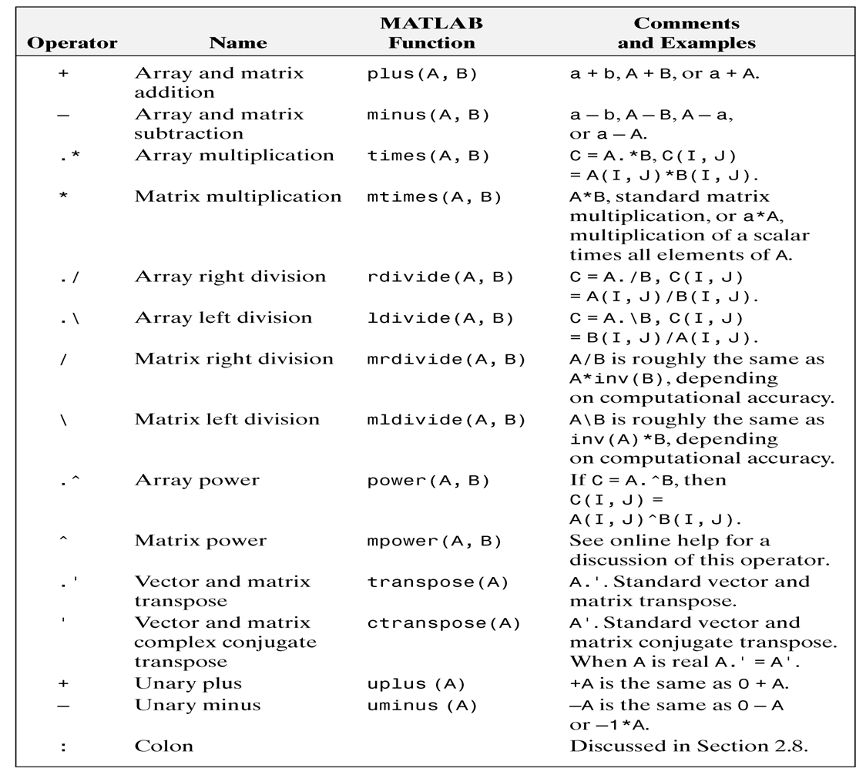
Matlab programming

Slide 26
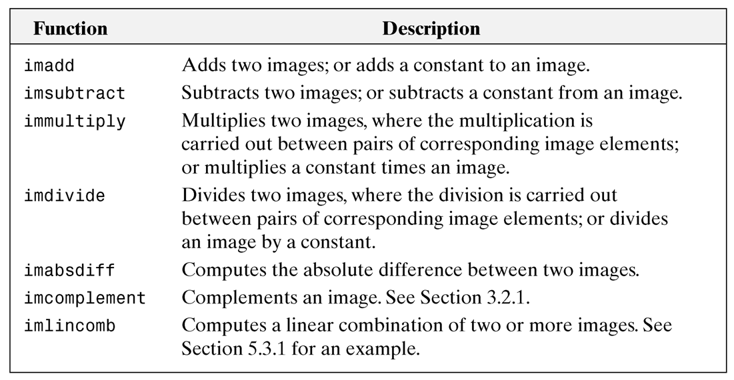
Matlab programming

Slide 27
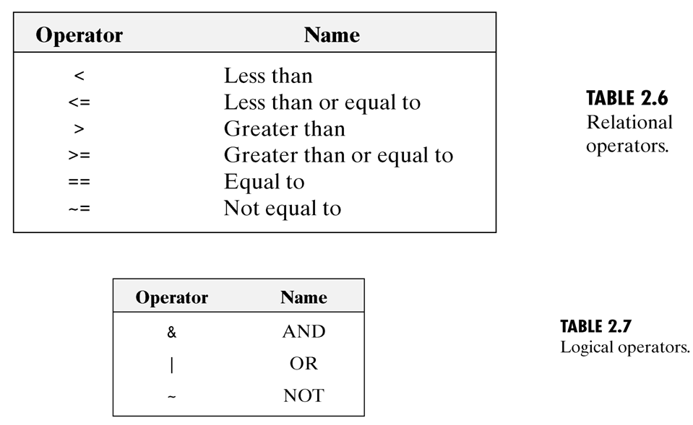
Matlab programming

Slide 28
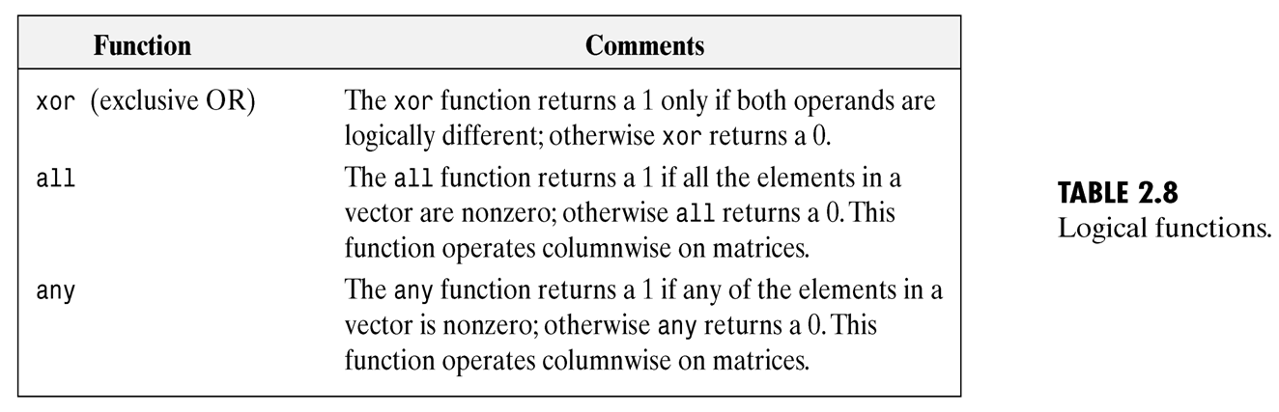
Matlab programming

Slide 29
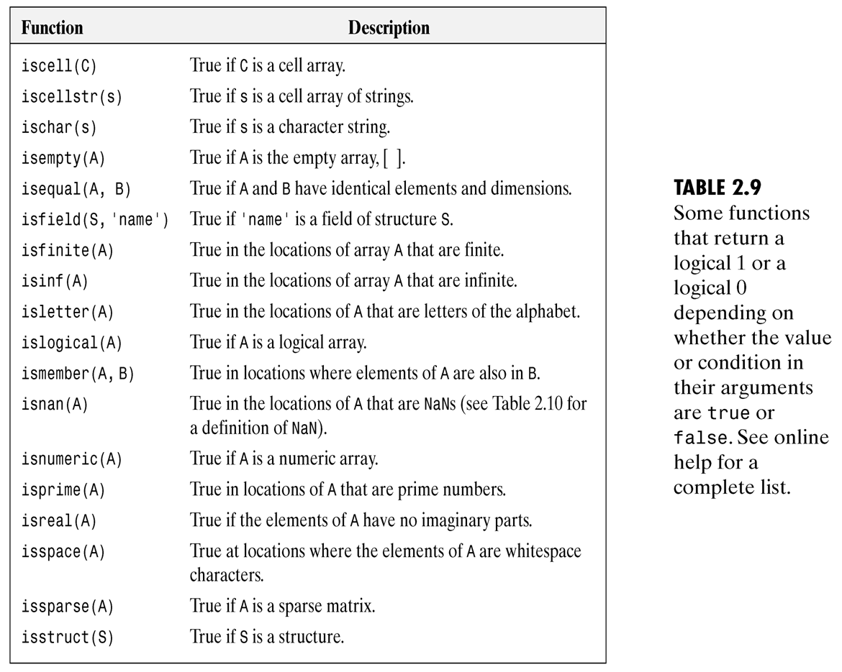
Matlab programming

Slide 30
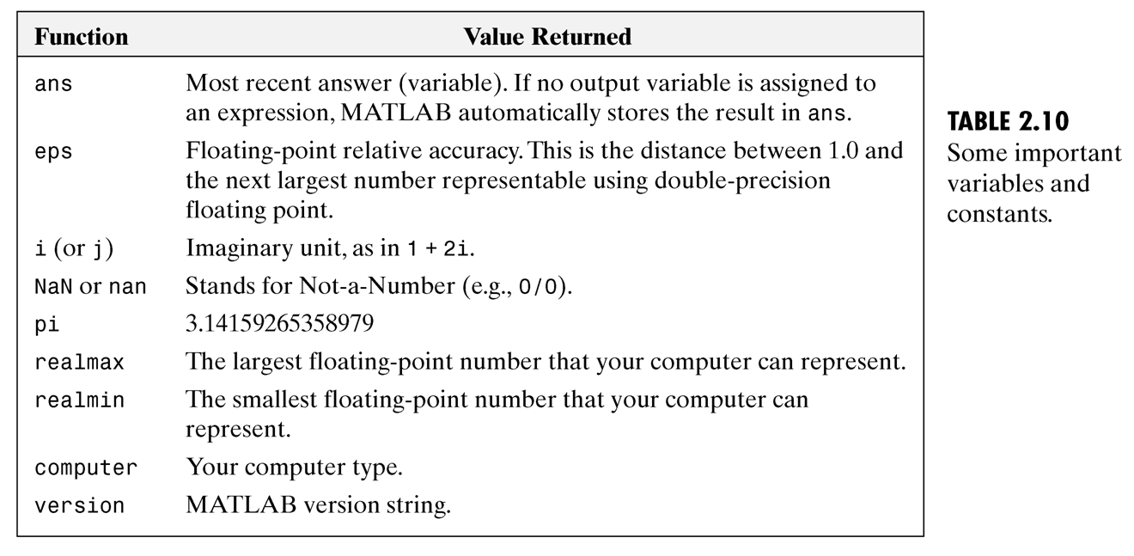
Matlab programming

Slide 31
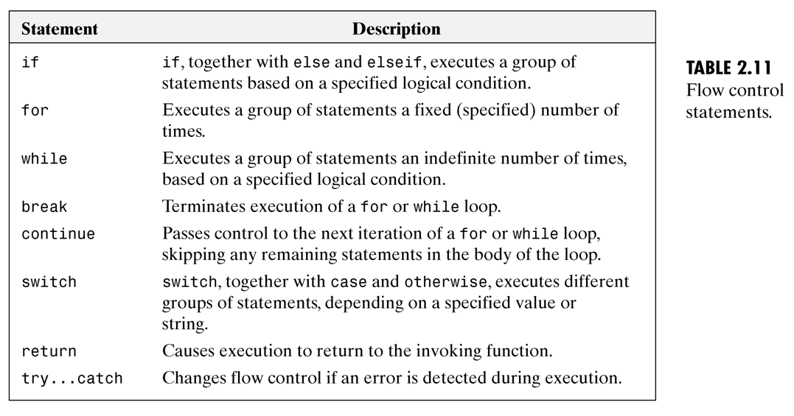
Introduction to M-Function Programming(cont.)
Matlab programming
Flow control
If,for,while,break,continue,switch,return,try...catch
...

Slide 32
Code Optimization
Matlab programming
MATLAB is a programming language specifically designed for array operations. Taking advantage of this fact whenever possible can result in significant increases in computational speed.
vectorizing loops preallocating arrays

Slide 33
Vectorizing loops
Matlab programming
Vectorizing simply means converting for and while loops to equivalent vector or matrix operations
As will become evident shortly, vectorization can result not only in significant gains in computational speed, but it also helps improve code readability
For example f (x) = Asin(x/2pi)
for x= 1:M
f(x) =A* sin((x-1)/(2*pi)); end
more efficient code by as follows: x=0:M-1;
f= A*sin(x/(2*pi));

Slide 34
Vectorizing loops(cont.)
Matlab programming
Similarly, using the meshgrid function,we can optimize the calculation of f (x, y) = Asin(ux + vy)
[C,R]=meshgrid(c,r)
This function transforms the domain specified by row vectors c and r into arrays C and R that can be used for the evaluation of functions of two variables and 3-D surface plots (note that columns are listed first in both the input and output of meshgrid).
An Example
c=[0,1] r=[0 1 2]
>>[C R]=meshgrid(c,r) C =
0 1
0 1
0 1
R =
0 0
1 1
2 2

Slide 35
Matlab programming
Vectorizing loops(cont.)
Useful functions h= R.ˆ2+C.ˆ2
h =
0 | 1
1 | 2
4 | 5

Slide 36
Preallocating arrays
Matlab programming
When working with numeric or logical arrays,preallocation simply consists of creating arrays of 0s with the proper dimension.
For example, if we are working with two images, f and g, of size 1024
× 1024 pixels, preallocation consists of the statements
f=zeros(1024);g=zeros(1024);
Preallocation helps reduce memory fragmentation when working with large arrays. Memory can become fragmented due to dynamic memory allocation and deallocation. The net result is that there may be sufficient physical memory available during computation, but not enough contiguous memory to hold a large variable. Preallocation helps prevent this by allowing MATLAB to reserve sufficient memory for large data constructs at the beginning of a computation.

Slide 37
Interactive I/O
Matlab programming
disp(argument)
If argument is an array, disp displays its contents. If argument is a text string, disp displays the characters in the string.
For example, A=[1 2; 3 4];
disp(A);
sc='Digital image processing'; disp(sc);

Slide 38
Interactive I/O(cont.)
Matlab programming
t=input(‘message') t=input(‘message', 's')
For example,
t=input(’Enter your data:’,’s’) class(t)
size(t) n=str2num(t) size(n) class(n)

Slide 39
Interactive I/O(cont.)
Matlab programming
>>t=’12.6, x2y, z’;
>>[a,b,c]=strread(t,’%f%q%q’,’delimiter’,’,’) a =
12.6000
b = ’x2y’
c =
’z’

Slide 40
Interactive I/O(cont.)
Matlab programming
strcmp(s1,s2)
returns 1 if strings S1 and S2 are the same and 0 otherwise.
For example, strcmp(b,’x2y’)
strcmp(b,’z’)

Slide 41
Cell arrays and structure
Matlab programming
Cell arrays
a cell array is a multidimensional array whose elements are copies of other arrays.
For example, c={’gauss’; [1 0;0 1],3} Structures
Structures are similar to cell arrays, in the sense that they allow grouping of a collection of dissimilar data into a single variable.
For example,
S.char string=’gucas’; S.matrix=[1 0;0 1]; S.scalar=3;

